Slide 1


Deep Neural Networks
Deep L-layer Neural network
deeplearning.ai

Slide 2
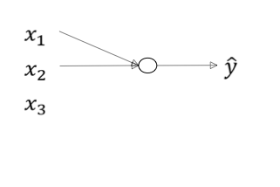
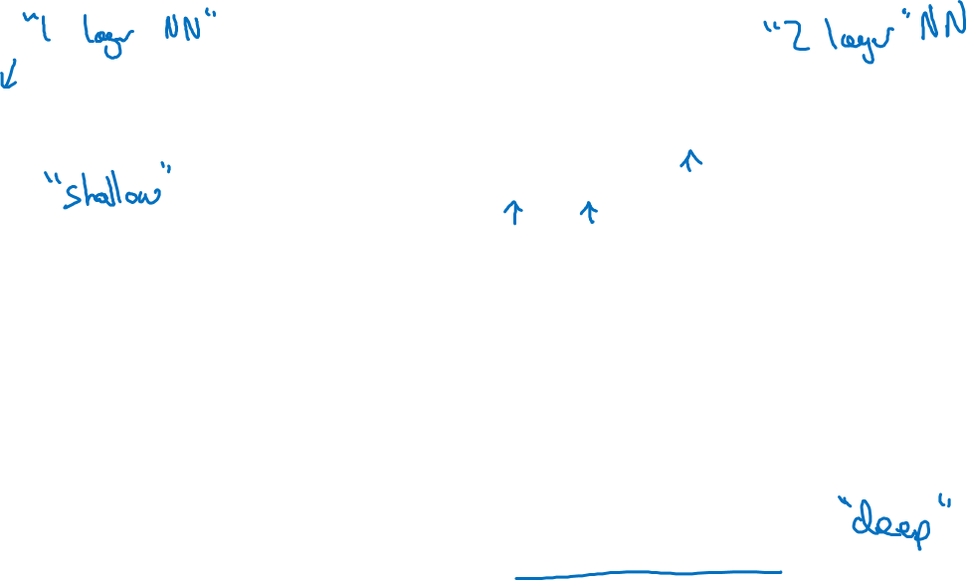
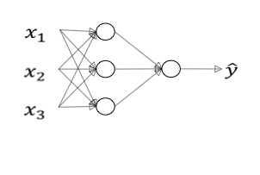

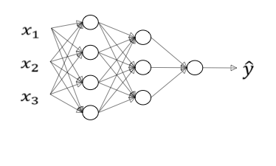
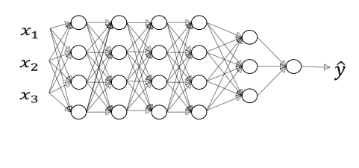
What is a deep neural network?
logistic regression
1 hidden layer
2 hidden layers
5 hidden layers
Andrew

Slide 3
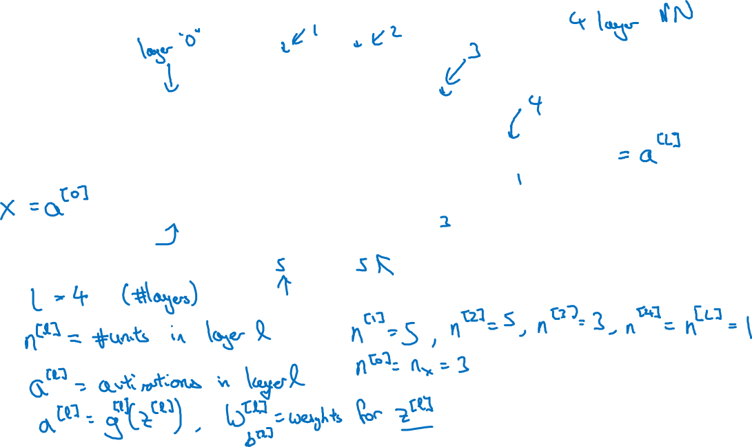
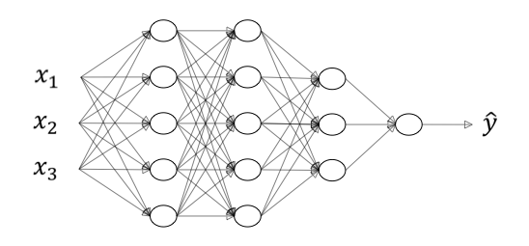
Deep neural network notation
Andrew

Slide 4
Deep Neural Networks
Forward Propagation in a Deep Network
deeplearning.ai

Slide 5
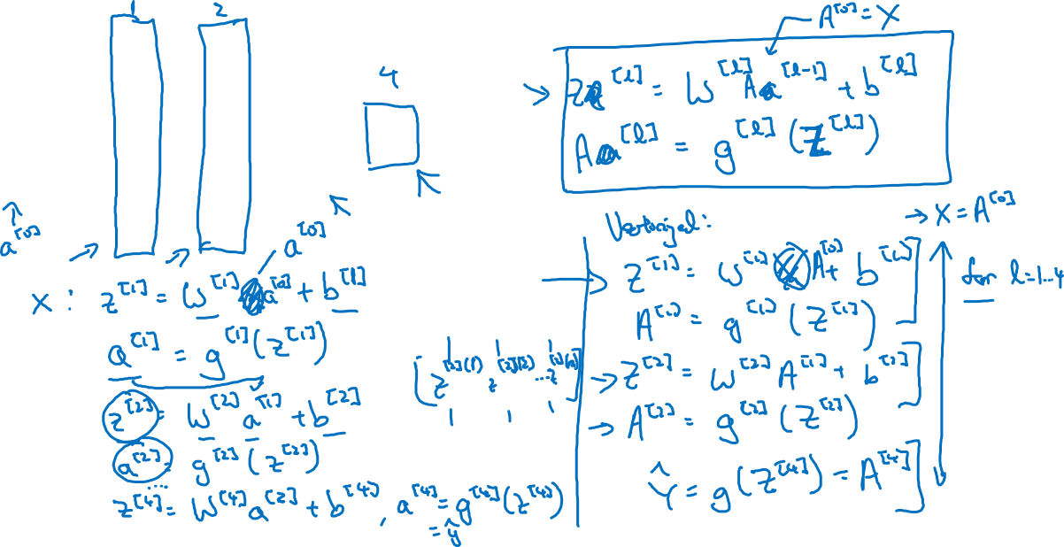
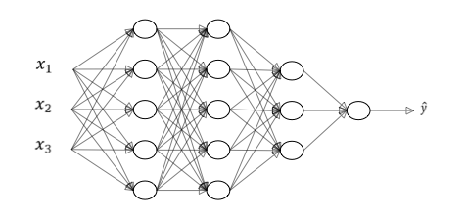
Forward propagation in a deep network
Andrew

Slide 6

Deep Neural Networks
Getting your matrix dimensions right
deeplearning.ai

Slide 7
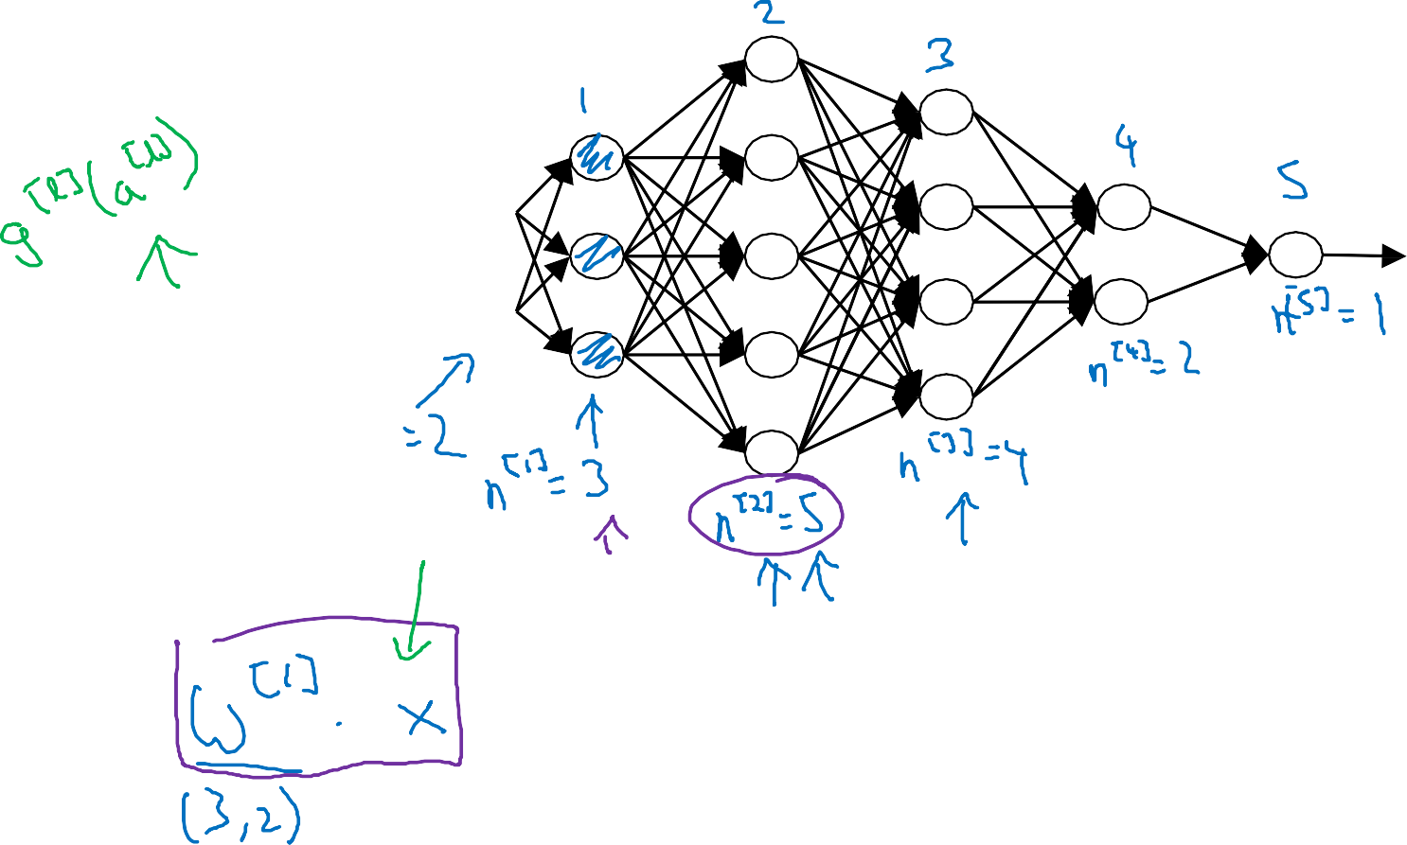
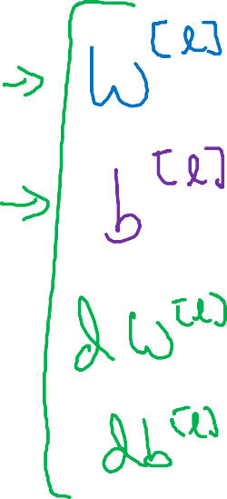






































Parameters !["] and "["]
&!
&"
$%
Andrew Ng

Slide 8
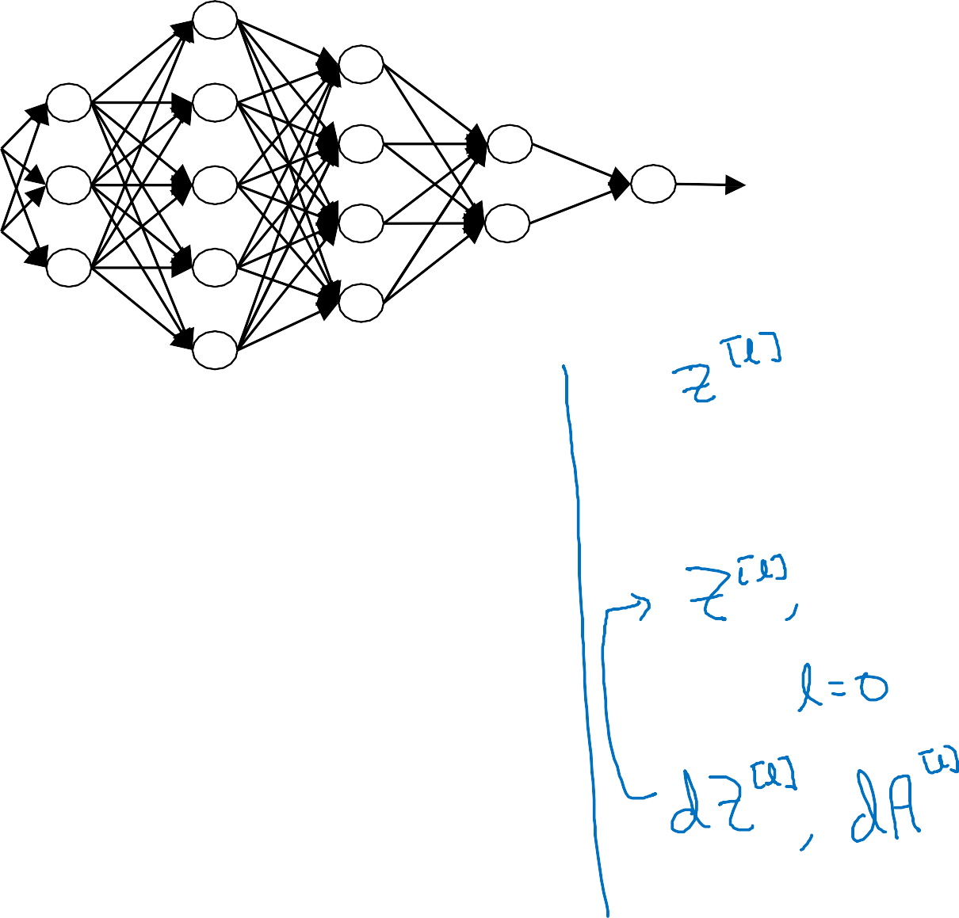



















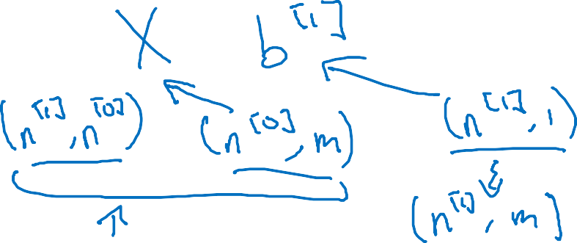






Vectorized implementation
#!
#"
!"
Andrew Ng

Slide 9
Deep Neural Networks
Why deep representations?
deeplearning.ai

Slide 10



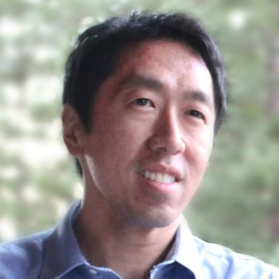


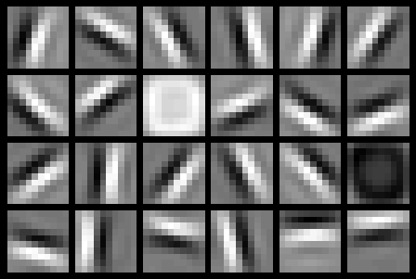
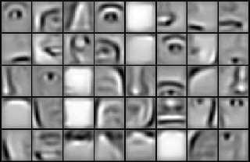
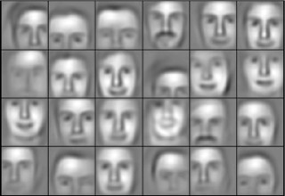

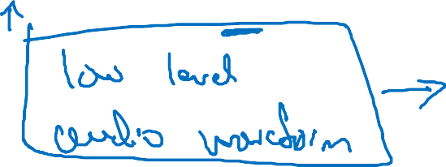









Intuition about deep representation
!"
Andrew Ng

Slide 11













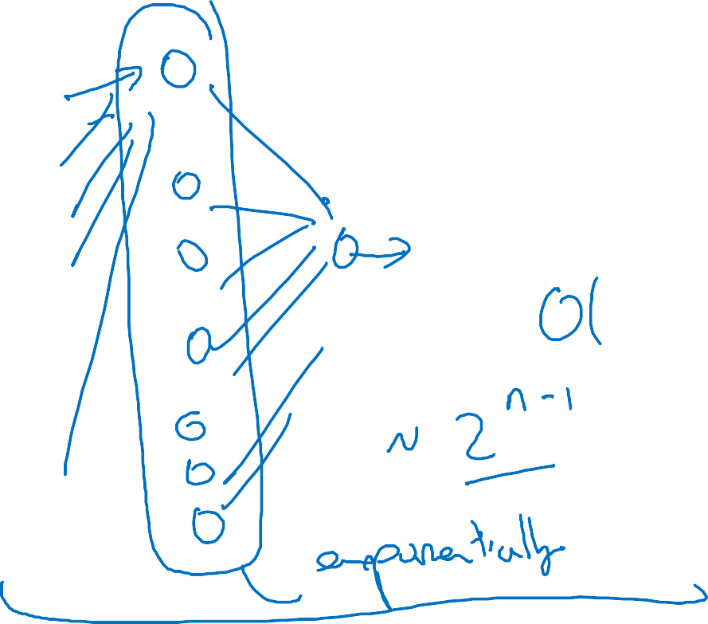

























Circuit theory and deep learning
Informally: There are functions you can compute with a “small” L-layer deep neural network that shallower networks require exponentially more hidden units to compute.
Andrew Ng

Slide 12
Deep Neural Networks
Building blocks of deep neural networks
deeplearning.ai

Slide 13
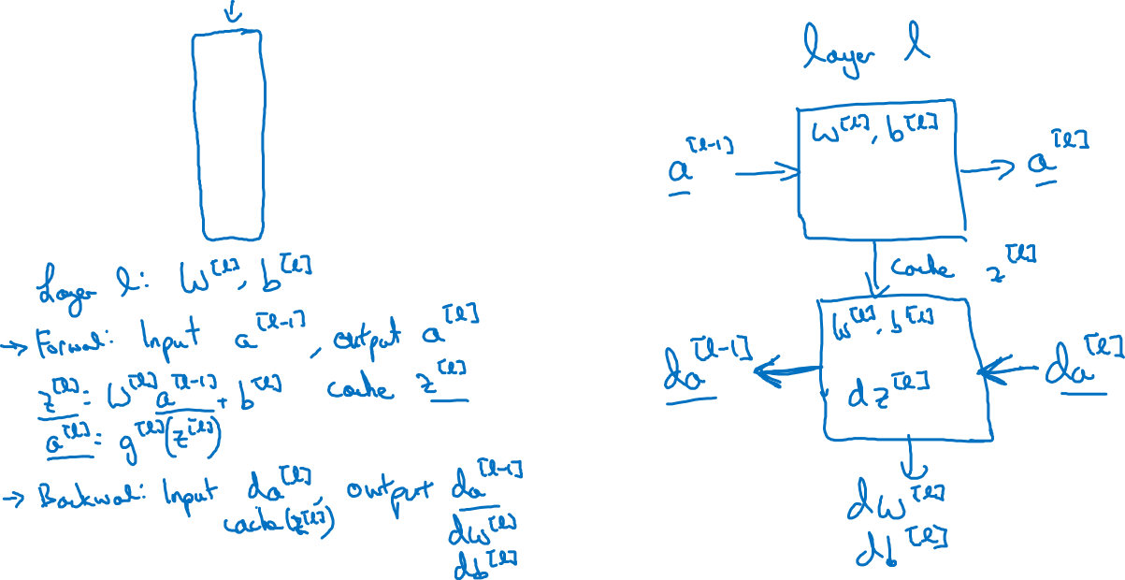
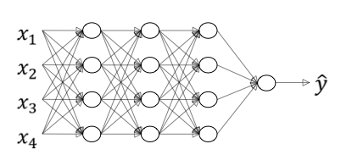

Forward and backward functions
Andrew

Slide 14
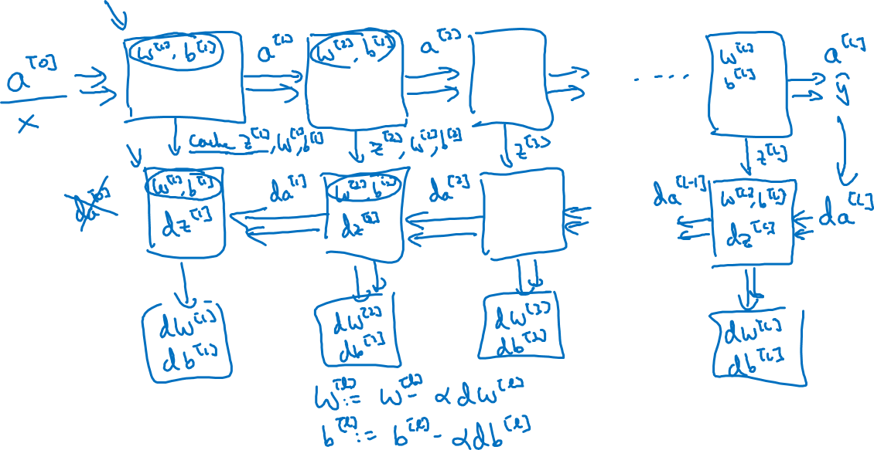
Forward and backward functions
Andrew

Slide 15
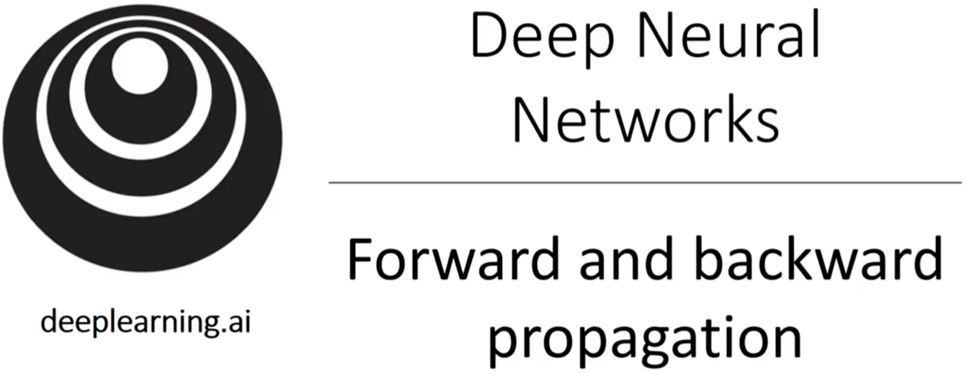

Slide 16
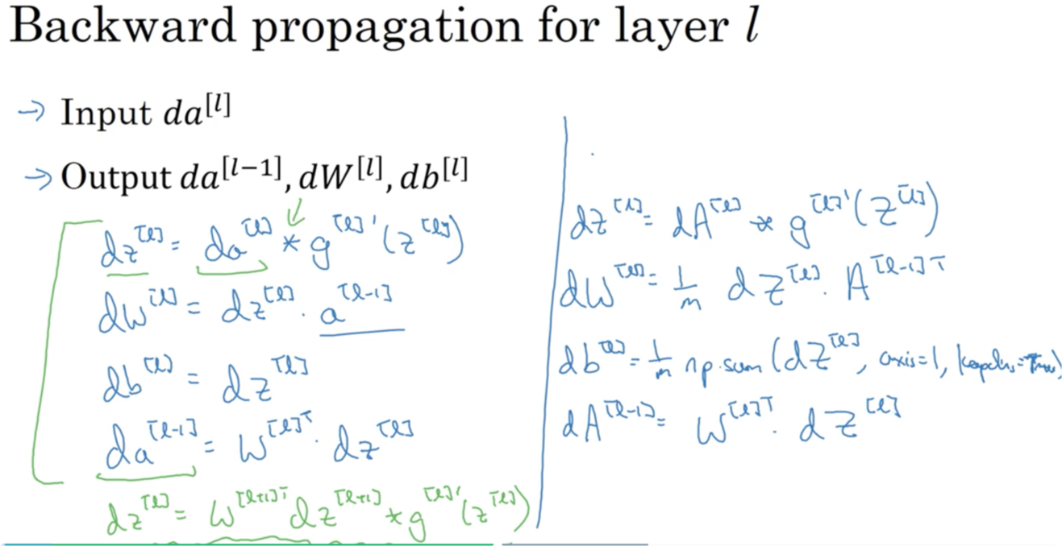

Slide 17
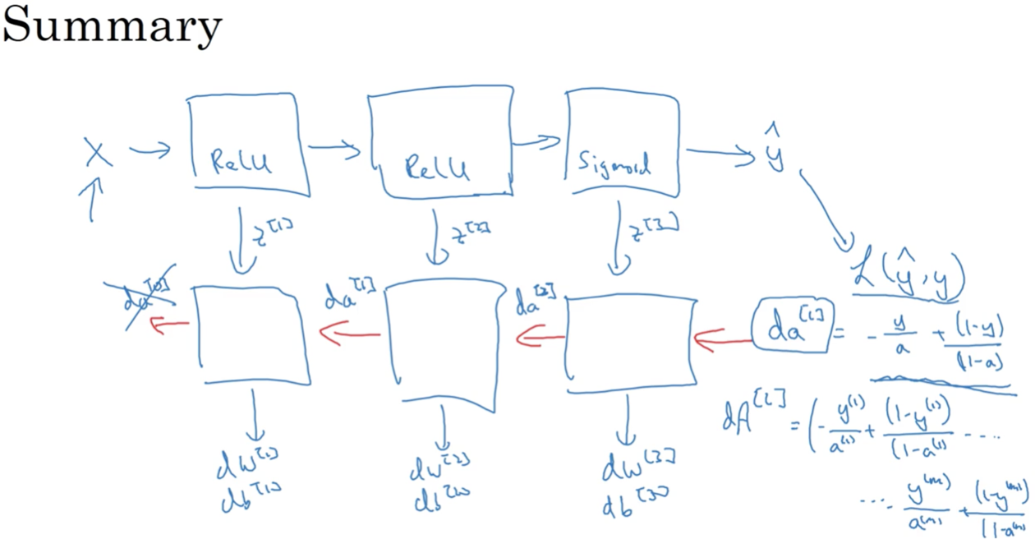

Slide 18
Deep Neural Networks
Parameters vs Hyperparameters
deeplearning.ai

Slide 19


















What are hyperparameters?
Parameters: ! " , % " , ! & , % & , ! ' , % ' …
Andrew Ng

Slide 20





Applied deep learning is a very empirical process
Idea
cost !
Experiment
Code
# of iterations
Andrew Ng

Slide 21
Deep Neural Networks
What does this have to do with the brain?
deeplearning.ai

Slide 22



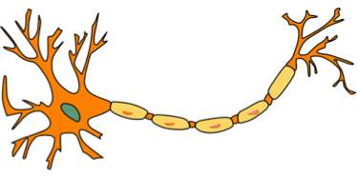






Forward and backward propagation
!["] _{= #}["]_{$ + &}["]
'["] = ( " (! " )
![$] _{= #}[$]'["] _{+ &}[$]
'[$] = ( $ (! $ )
_{-!}[%] _{= '}[%] ₋ ₊
-#[%] = ¹ -! % ' % &
0
-&[%] = ¹ 12. sum(d! % , 9:;< = 1, =>>2-;0< = ?@A>)
0
_{-!}[%'"] _{= -#} % &_{-!} % ₍( % _{(!} %'" ₎
-!["] = -# % &-! $ (^{( "} (! " )
…
'[%] ₌ ₍ % ! %
= +,
…
-#["] = ¹ -! " ' " &
0
-&["] = ¹ 12. sum(d! " , 9:;< = 1, =>>2-;0< = ?@A>)
0
Andrew Ng

